Slide 1
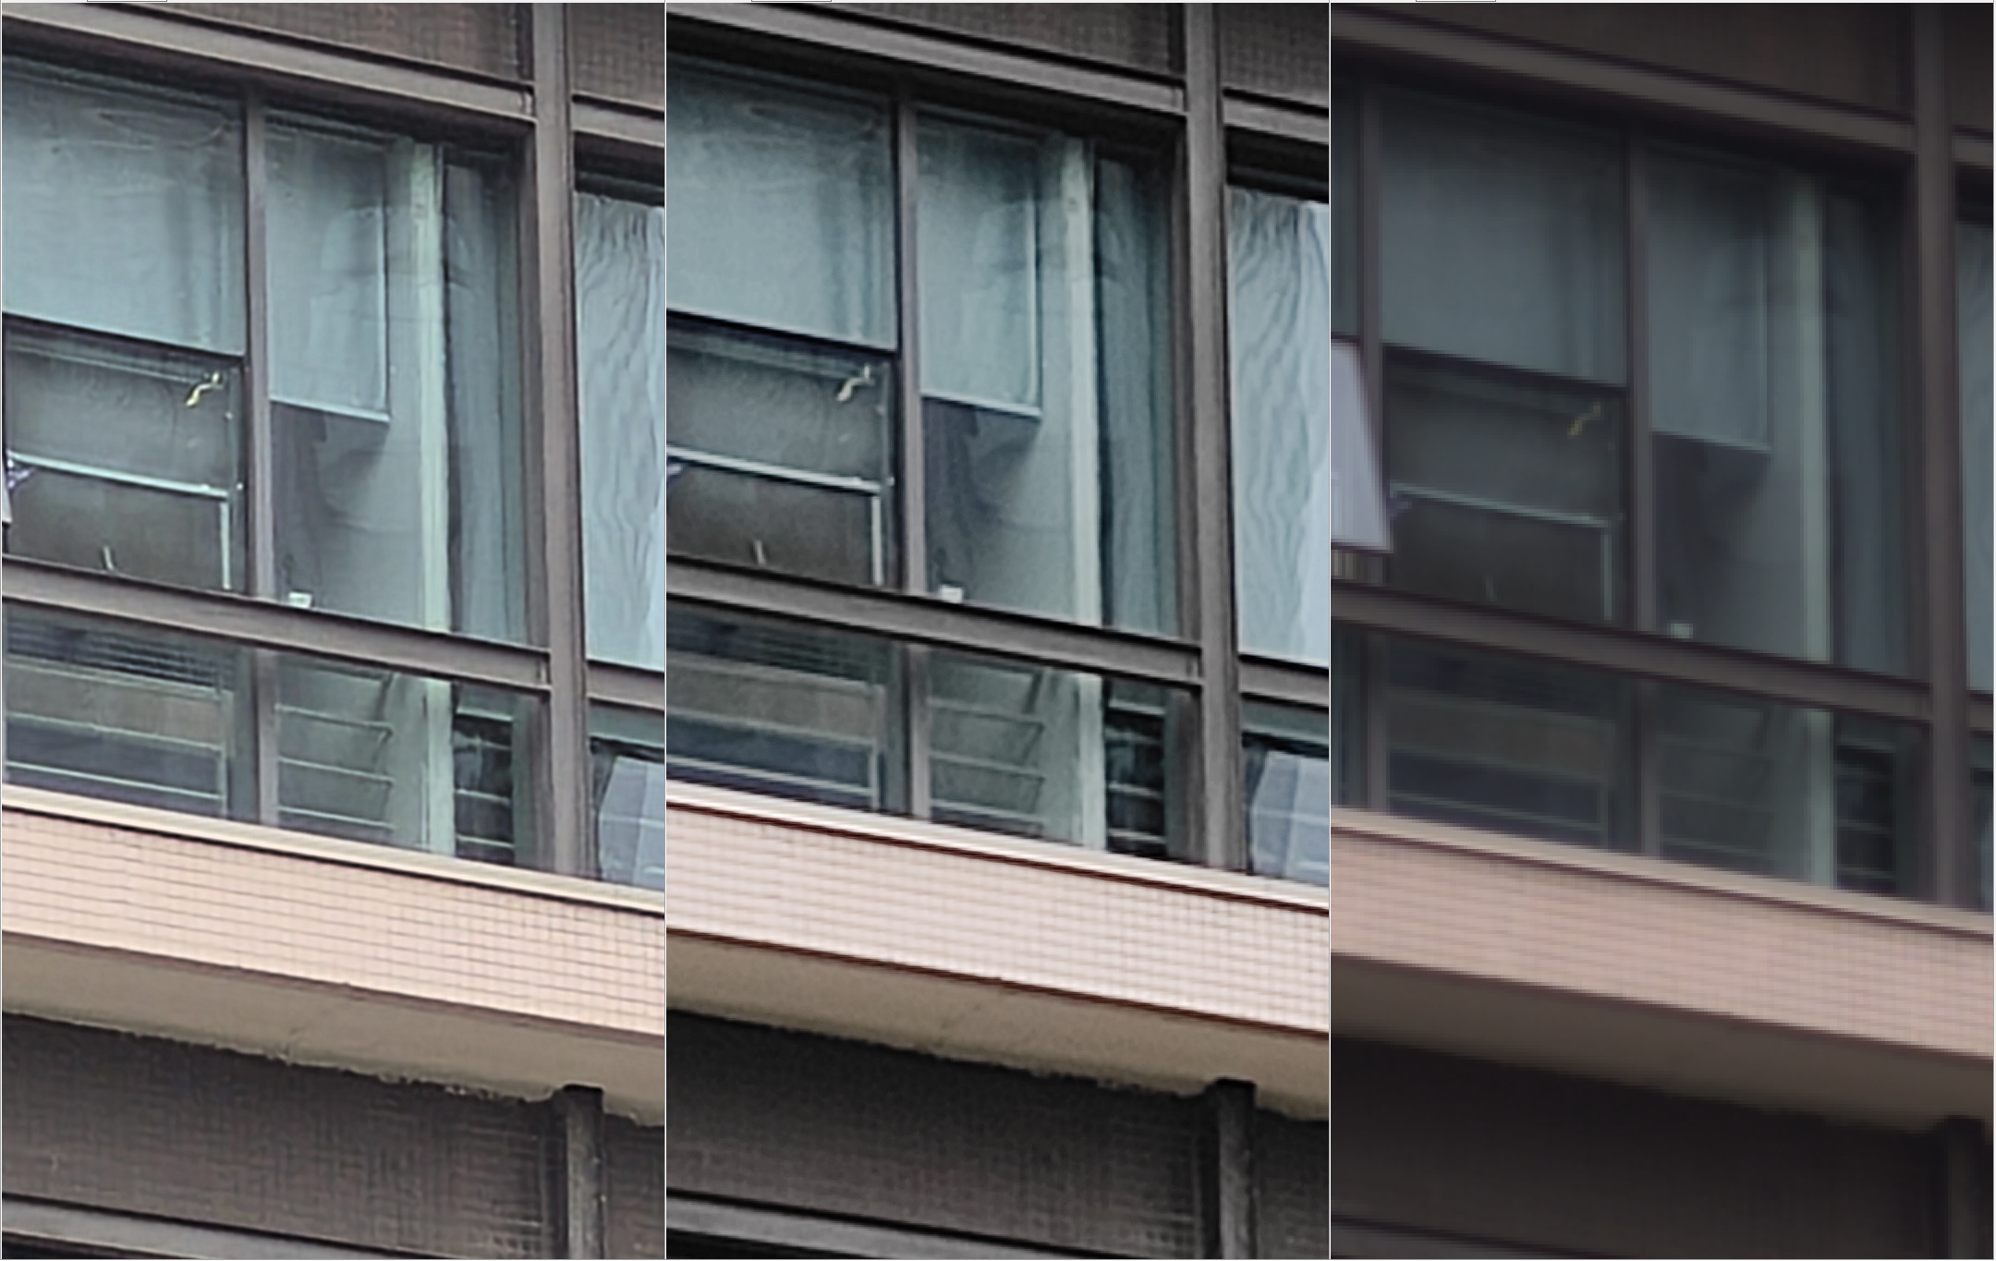
Ours
SenseTime
Input
Ours
SenseTime
Input

